Slide 1
Data Analytics Pipeline
Lecture 1: January 28, 2019

Slide 2
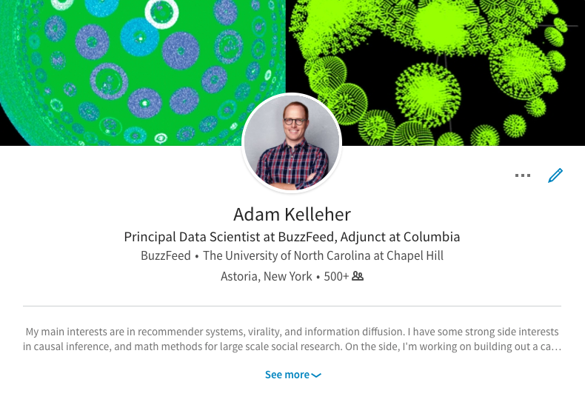
Who Am I?

Slide 3
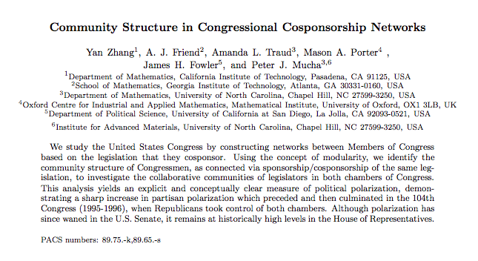
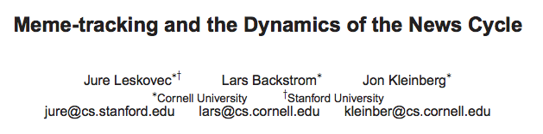
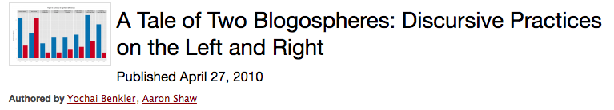
Why BuzzFeed?

Slide 4
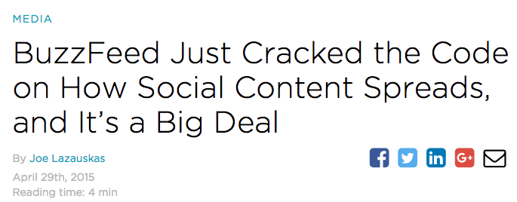
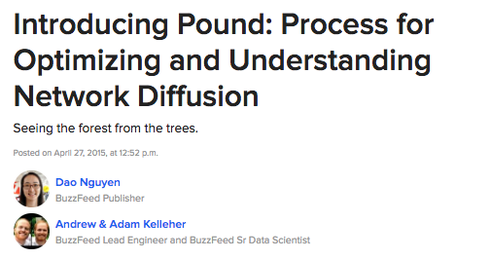
POUND
Process for Optimizing and Understanding Network Diffusion

Slide 5
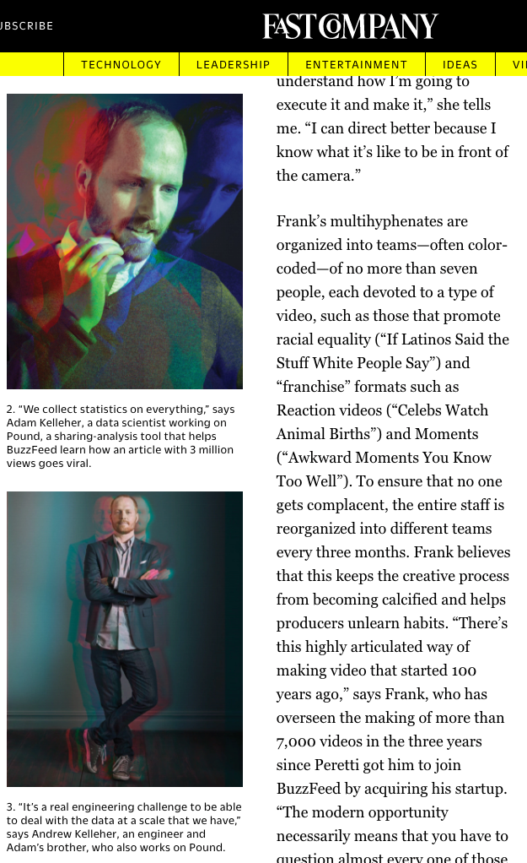
(With my triplet)

Slide 6
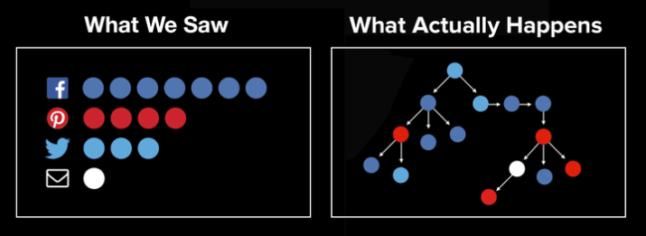
The basic idea...

Slide 7
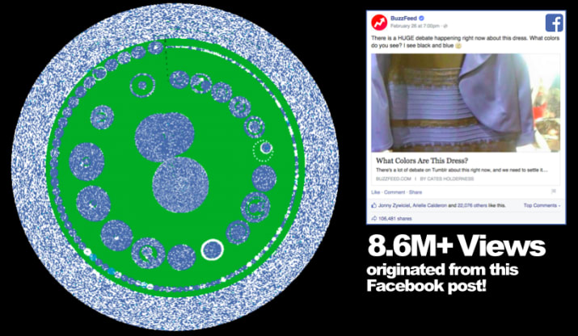
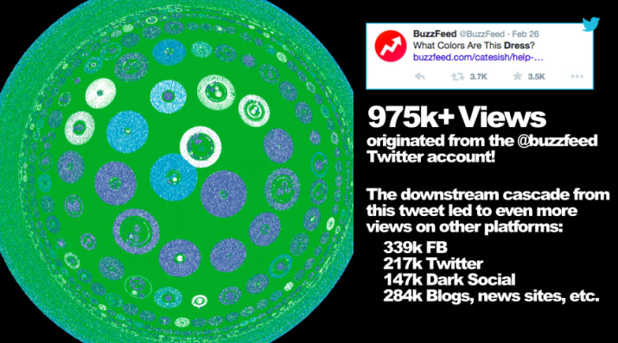
Some cool data visualization...
Notes:
But with real business implications.

Slide 8
More recently
Finishing at BuzzFeed
New ad methodologies
Recommendation ML platform
Starting at Barclays
Building a team and infra
Writing data-driven investment research
Surveying ML and data products

Slide 9
Brief History of Machine Learning (products)
Context

Slide 10
Linear Regression (Galton; Pearson)
Graphical Models (Pearl)
DNNs reach human performance across many tasks
1890s
1965
1988
1990
2009-present
Multi-layer NNs (Ivakhnenko and Lapa)
(stagnation around 1969)
Boosting (Schapire)

Slide 11
Linear Regression (1890s)
Still used often today!
Great go-to model for basic tasks
Logistic regression for fraud detection
Linear regression for causal inference
Many variants solve some problems
Robust linear regression
Different link functions for different tasks

Slide 12
Shortcomings
Very little model freedom, but you could get some non-linearity
Lots of independence assumptions
Trouble with collinearity!

Slide 13
Hierarchical Regression (~1970s)
Adds some model freedom
Allows some collinearity
Better statistics, especially for small data sets

Slide 14
Hierarchical Regression
Adds some model freedom, in the sense of more complex dependence structure
Allows some collinearity, and “partial pooling”

Slide 15
Graphical Models
Allows much more general dependence
Generative model for the data
More computational tools available for fitting and making assumptions

Slide 16
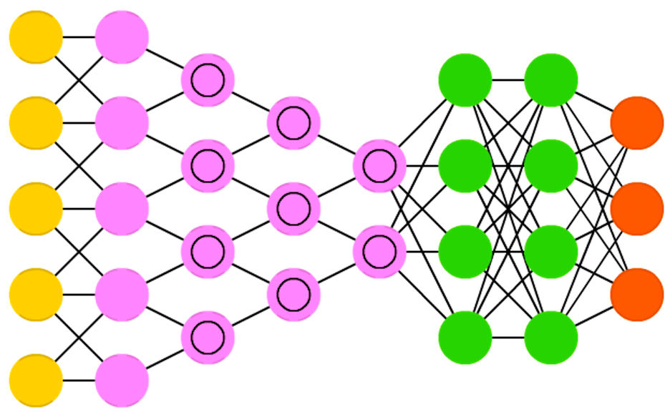
Neural Networks
General function approximators
Much more computational machinery, regularization methods, etc developed
Very non-linear
Solving is expensive!

Slide 17
Why the stagnation?!
Too little computing power
Couldn’t even fit XOR

Slide 18
But then...
Technology developed: faster computers, bigger data sets
Discovered backprop algorithm!
Greedy pre-training (solves vanishing gradients)
Batch Normalization; Dropout; new architectures
Machine learning frameworks like TensorFlow and PyTorch were released!

Slide 19
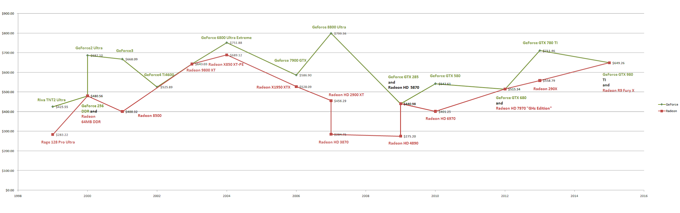
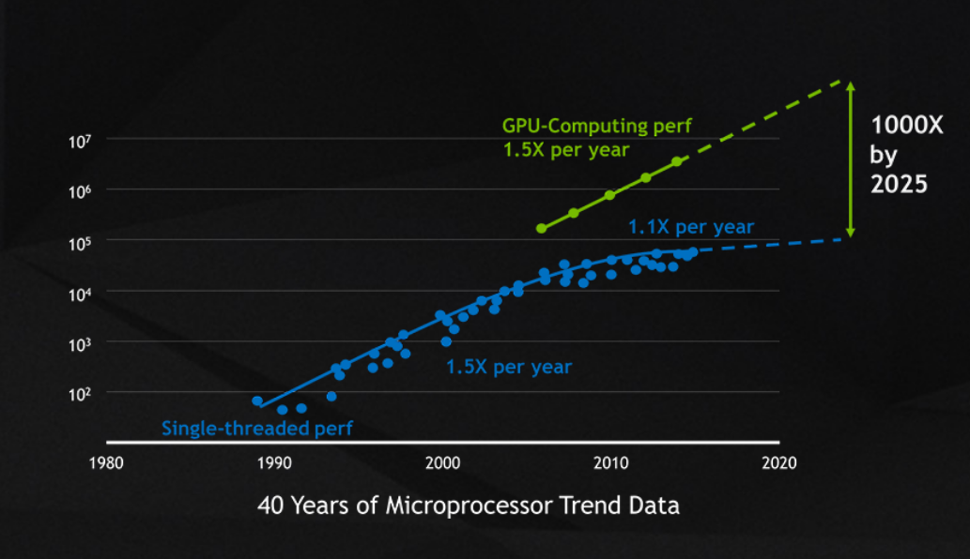
The Result
Costs stayed flat or decreased while compute power rose
High-power computing effectively became cheaper
Neural Net frameworks and machine learning packages became available
Many more products are built with advanced ML technology!

Slide 20
What does this mean for applications?
Problems that only humans could do can now be performed by computers: large scale data processing!
Higher and higher skill level tasks can be automated (e.g. language translation)
You don’t have to be an ML researcher to build cutting-edge ML products
Notes:
Astronomy observation classification! Manual → automated tagging

Slide 21
Example Applications
From an image, recognize the objects in the image
Translate French text into english
Win a game of Go
Predict the click-rate of an advertisement
Model user engagement with a website or app

Slide 22
How do we do these in context?!
From an image, recognize the objects in the image

Slide 23
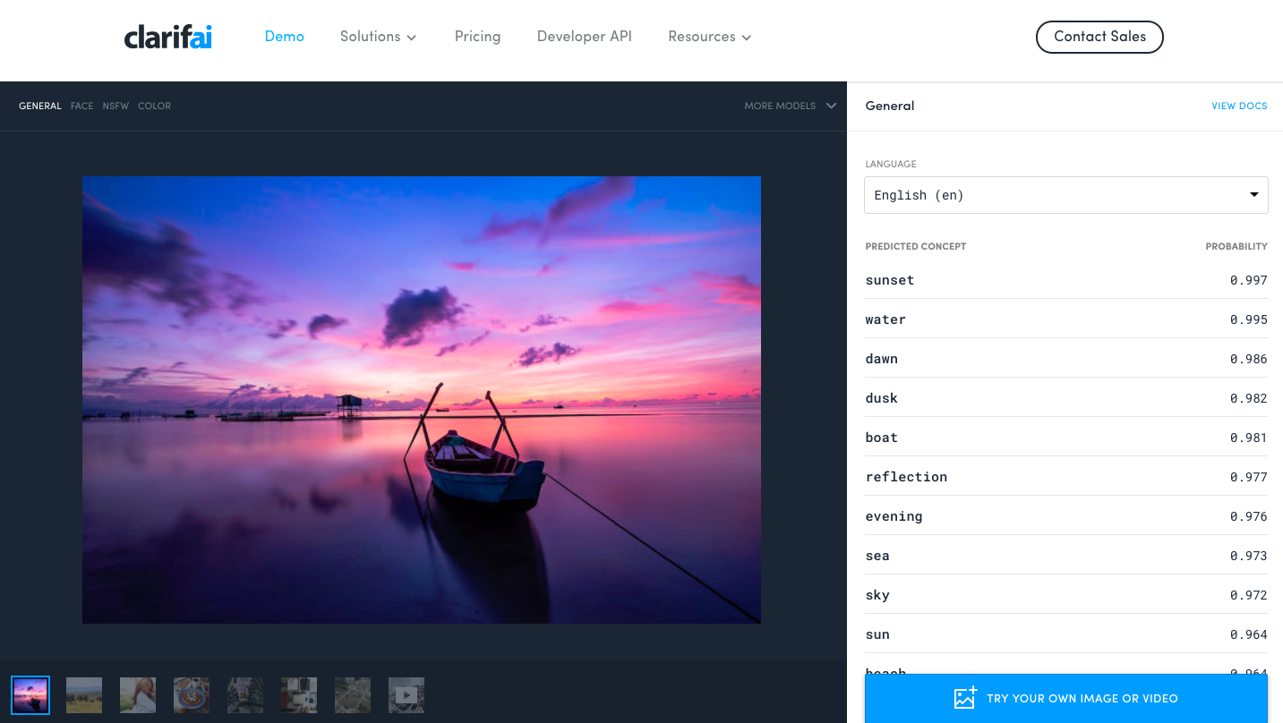
How do we do these in context?!
From an image, recognize the objects in the image

Slide 24
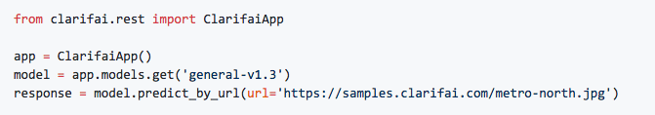
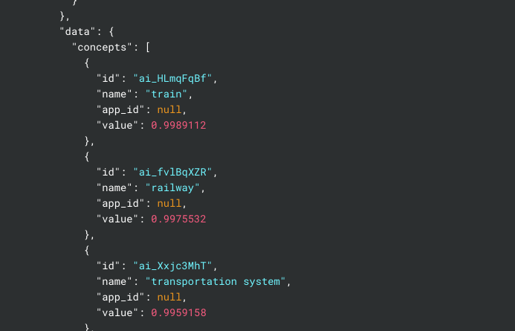
Some pointers:
Your first choice should probably be to look for an API to use
If one isn’t available, see if a pre-trained network works
If not, see if you can use transfer learning with unsupervised data (supervised data is expensive!)

Slide 25
What components are required to build this yourself?
Model Service?
Model Trainer?
Deploy scripts?
API service?
Web application?
Design team?
Front-end developers?
...

Slide 26
Things can get pretty complicated
Input
Data
Training
Prediction
API
Notes:
Each service is an independent component.
Training: read the data, learn the model.
Prediction: take data from the API call, run the model to produce an output. Actual model lives here.
API: interface with the real world. Take data from the user.

Slide 27
Things can get pretty complicated
Prediction
Input
Data
Training
Prediction
Load
Balancer
API
Prediction

Slide 28
And so on...
Prediction
Input
Data
Training
Prediction
Load
Balancer
Prediction
API
Prediction
Input
Data
Training
Prediction
Load
Balancer
Prediction
...

Slide 29
Maintenance Requirements
What happens when we have to go from python 2.x to python 3.x?
when libraries get deprecated
when we want to upgrade neural net frameworks
when we want to update models
when we want to update the endpoint formats

Slide 30
More features = more maintenance
More components can break
More bugs can be introduced
More code to forget about
Takeaway
With new opportunities, product design principles are the same: keep things minimal!

Slide 31
Course Concepts and Goals
Understand the idea of a value proposition
Learn product-driven data science
Build data dashboards, and learn the backend systems that support them
Understand agile development
Build different types of microservices, including REST APIs, queuereaders, and model trainers
Learn some basics of data architecture
Detail some real machine learning frameworks
Understand the product development and iteration process

